Slide 1
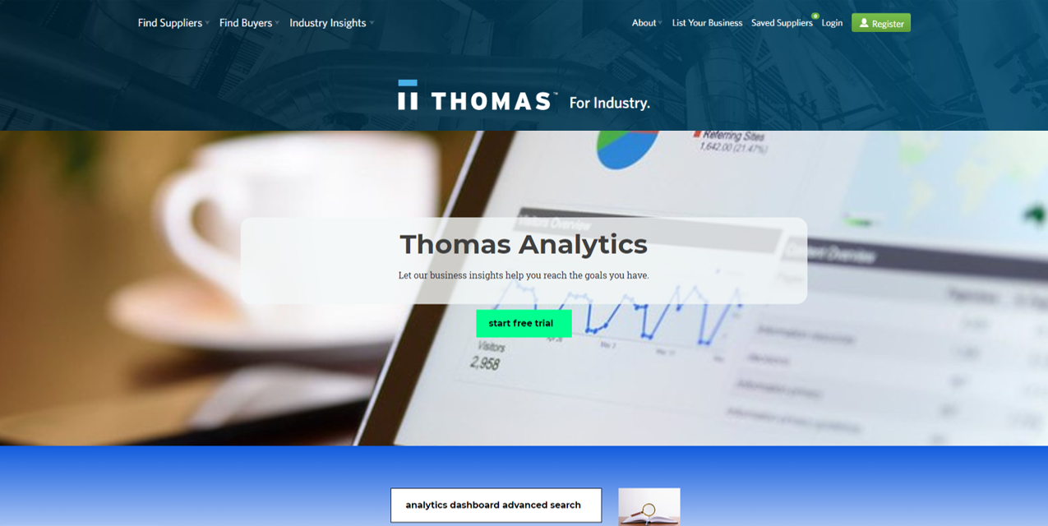
Group 7 final report
Thomas Analytics

Slide 2
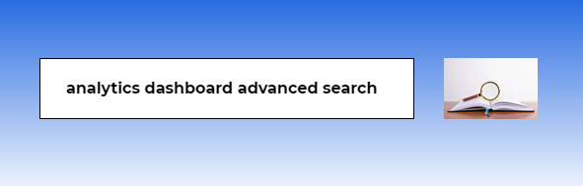
Thomas Analytics overview
Thomas Analytics is a data visualization and dashboard bank for customers in the united states who need business insights but don’t have the knowledge, team, time and data to create their own dashboards and data analysis. They can have access to visual facts and interactive dashboards on a subscription plan.

Slide 3
Problem/The need for Thomas analytics
Facts can inspire great ideas, facilitate decision making and great ideas
Businesspeople and small companies in United States are looking for industry insights to help them make decisions BUT:
*Not all of them have the knowledge, team, time and databases to build and extract insights from dashboards and data analysis
*There are not many resources that provide varies industry resources in one place.
*Statista website is a competitor providing similar services, but it is not focused on United States, so it makes it harder to find U.S. industry websites. It is expensive and they don’t have access to Thomasnet valuable databases.
***
There are millions of people looking for business insights
*Statista has 2,000,000 users and 23,000,000 visitors per month

Slide 4


Solution
Thomasnet Analytics is a webpage as an extension to Thomasnet current website. It contains numerous interactive dashboards and offers U.S. industry-Wide analytics through a subscription plan which monetizes Thomasnet available data and take advantage of free public data.
Let’s call it a dashboard bank and search engine.
Thomasnet interactive dashboards gives meaningful insights to the customers., suppliers, investors, economists and other potential customers. The interactive dashboard will help the users in analyzing the market trends, geospatial analysis of demand, peak hours of activity on the website, effects of sudden effects such as COVID on various industries, in-depth analysis of the manufacturing industry in different states, etc. This will help in increasing the number of subscribers for the website.

Slide 5
Thomas net advantage over the competitor- Statista
US. Focused-easy to find U.S data
Exclusively offer insights from Thomasnet data bases
Cheaper subscription fee

Slide 6
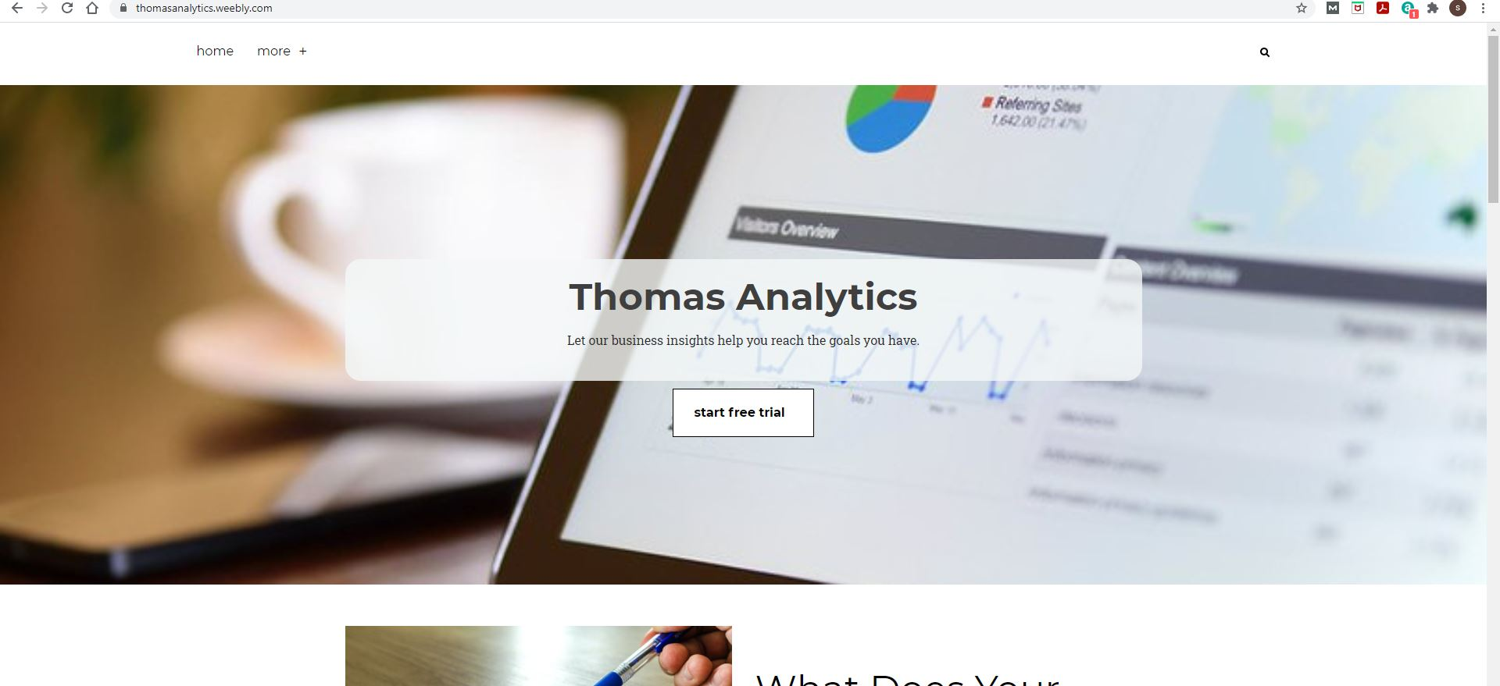
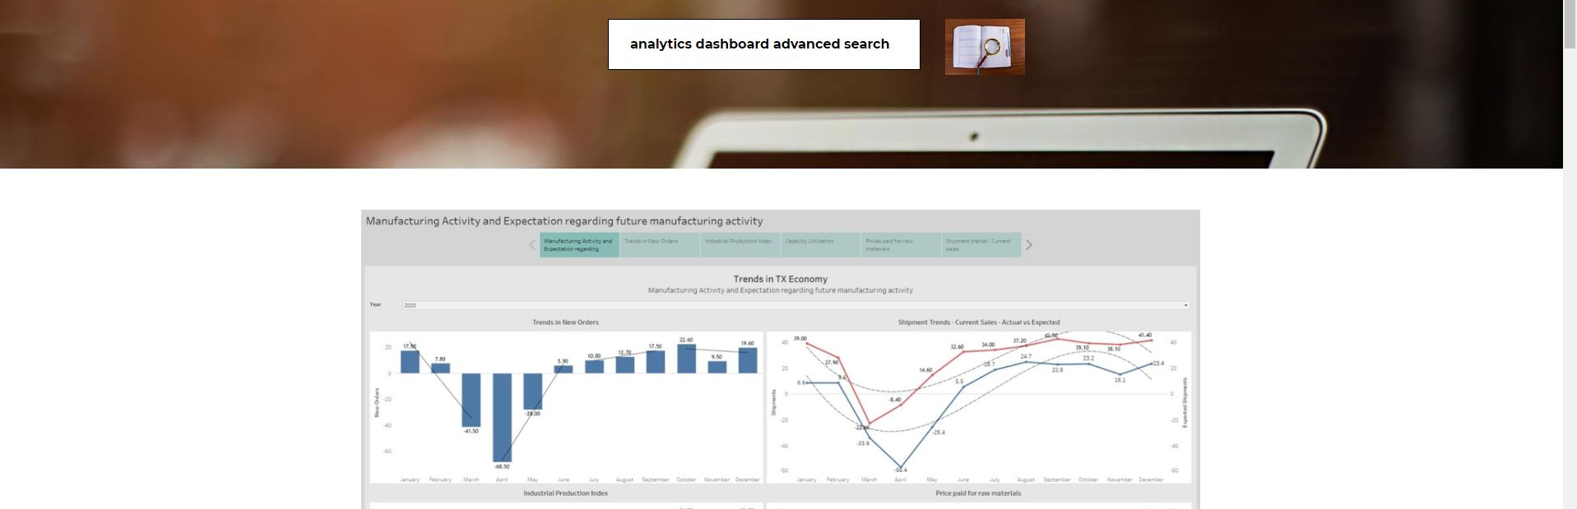
Website prototype
Thomas Analytics

Slide 7
Thomas Analytics features
Thomas analytics will act as a one-stop-shop for existing customers, prospective clients, and investors. The dashboards will gather data from multiple sources into a single interface, with an extension to append additional data from all available publicly available datasets such as U.S. Census bureau, etc. Dashboard will provides a dynamic experience and will have features that allow the users to filter and customise visualizations as per their preference. Also there is an option for customers to build their own dashboards using Thomas Analytics available data. So, they don’t need to go through hassle of finding and preprocessing data. Ad-hoc reporting will also be accessible to the users.

Slide 8
Marketing Strategy
Investors and suppliers are the main target customers but also there are other potential customer segments such as businessmen, economists, policymakers, etc.
Thomasnet can easily advertise Thomas Dashboard to its current customers through it’s website and customers’ emails.
Thomasnet can advertise on other platforms such as Google, Youtube and other potential marketing solutions using its marketing Budget.
An effective lead follow-up process can ensure that Thomas doesn’t miss out potential opportunities. Segmenting target customers by their visiting, buying activities helps company putting efforts into right targets and in turn reducing the follow-up costs.
Segmentation will be made on visit time. Visit frequency of each visitor serves as another aggregation factor. Users can define their own parameters and granularity to apply segmentation operations. The target visitors will be filtered out and listed in a dashboard table for easy access.

Slide 9
What Data
Thomas industrial data covers a variety of visitor access information which would help clients make better business decisions and get access to insights based on the trends in the economy and based on the past behaviours of the visitors and the manufacturers associated with ThomasNet.
Additional Data - As a user case example : Texas Manufacturing Outlook Survey initially
Many more publicly available datasets in next phase
We find that the most popular supplier industry on Thomas Net is the manufacturing sector.
In order to provide insights regarding the trends in the Texas economy concerning the manufacturing sector, we display various trends in the economic factors that have a lasting effect on the economy and are of grave importance to the suppliers, manufacturers, investors and other potentially interested parties.
Scope: As the data provided by Thomas Net is regarding TX imports and exports, we decided to use TX manufacturing survey data to generate economic insights. The real dashboard includes all the states.
Notes:
Visitors in different industry fields access the website for suppliers from different states of US. Time for each query from a visitor is also recorded. Visitors in different industry fields access the website for suppliers from different states of US. Time for each query from a visitor is also recorded.The Dallas Federal Reserve Bank of Dallas conducts the Texas Manufacturing Outlook Survey monthly to obtain a timely assessment of state’s factory activity. Firms are asked whether output, employment, orders, prices and other indicators increased, decreased or remained unchanged over the previous month.

Slide 10


Use Case 1 - Thomas Analytics business value to an example seller
How much enlisting on Thomas Net will increase website traffic?
How to increase the traffic on my company’s website?
Which industries my potential customers come from so I can customize the promotions and ads?
JOHN DOE – Owner of a small electrical company
What business values Thomas analytics offers to John?
?
John wishes to increase his revenue by making his website more popular and running ads. He has some questions to proceed further
Where do the target customers reside so I can target them using geotargeting ad?
What is the best time to run ads for target customers?
Notes:
John Doe is the owner of a small electrical components company.
He wishes to increase the traffic on his company website. He is not sure if enlisting in Thomas Net would yield expected results for the website.
Launch a marketing campaign to attract more customers.
He is wondering where do the target customers reside so I can target them using Geotargeting?
And what is the best time to target them using ads.
He also wants to know which industries the target customers come from so he can customize the promotions he is offering
Inventory trends

Slide 11
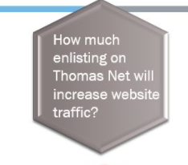

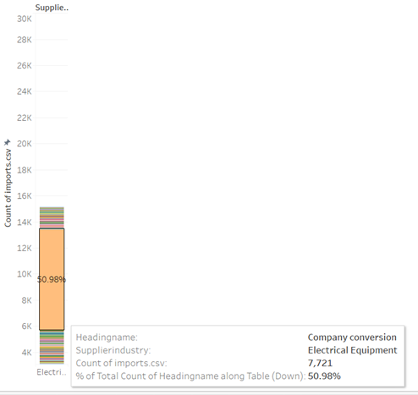
USE CASE
John Doe is the owner of a small electrical components company. He wishes to increase the traffic on his company website. He comes across Thomas Net; but he is not sure if enlisting in Thomas Net would yield expected results for the website. He navigates through the Thomas Analytics dashboard and discovers a visualization displaying the conversion rate (the percentage of visitors that redirected to a supplier’s website through Thomas Net) of each supplier industry. He customized the plot and observed that the electrical equipment industry has a hefty conversion rate of 50%. This strengthened his reason to enlist on Thomas. After three months of enlisting on Thomas Net, the traffic on his website increased by 20%.

Slide 12
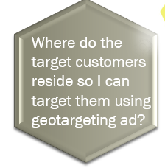
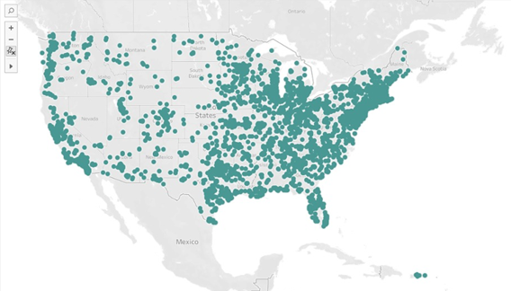
TARGET AUDIENCE
After the increase in traffic on his website, John wishes to launch a marketing campaign offering lucrative deals via advertisements to attract more customers. He is unaware of the location of target audience and is unsure as to which direction he should proceed in for the campaign. After spending some time on the dashboard, navigating through different visualizations, he is able to determine his target audience location and best time to target them with ads.
Most of John’s customers reside in the east. Few of them reside in the west and fewer in central US. The best time to promote his service is from 3 PM – 9 PM with highest activity at 8 PM, and the best days to promote are Monday through Friday with Wednesday with the highest activity. Another interesting metric that John observes is that the demand for electrical equipment is highest in the month of October, this means that John must ensure that he is stocked up for that month to avoid shortage of supply.

Slide 13

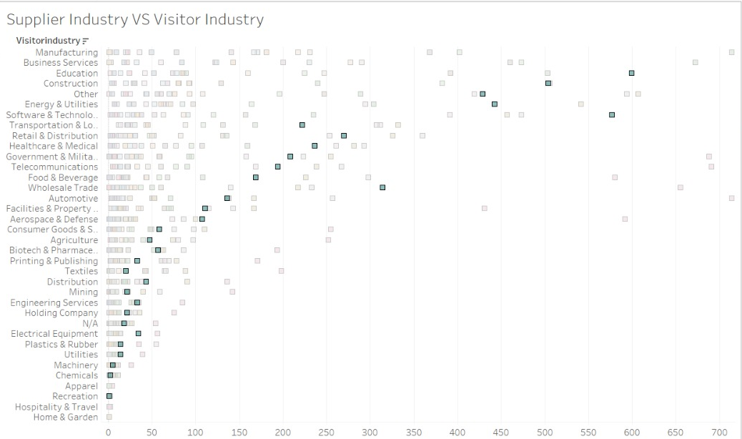
MARKETING CAMPAIGN
Now that John understands his target audience, he would like to start advertising his product. But he is uncertain about the sort of deals he would like to offer to his customers.
Through the supplier vs visitor industry visualization, John is now aware that most of his customers are either from the education industry or software and technologies industry. Based on this knowledge, John can design his advertisements to attract customers from the above industries.

Slide 14
Connecting additional public data- Texas manufacturing dataset
In addition to increase his current revenue, John has decided to expand in manufacturing sector, he searches through Thomas Analytics to find supporting reasons to proceed.

Slide 15


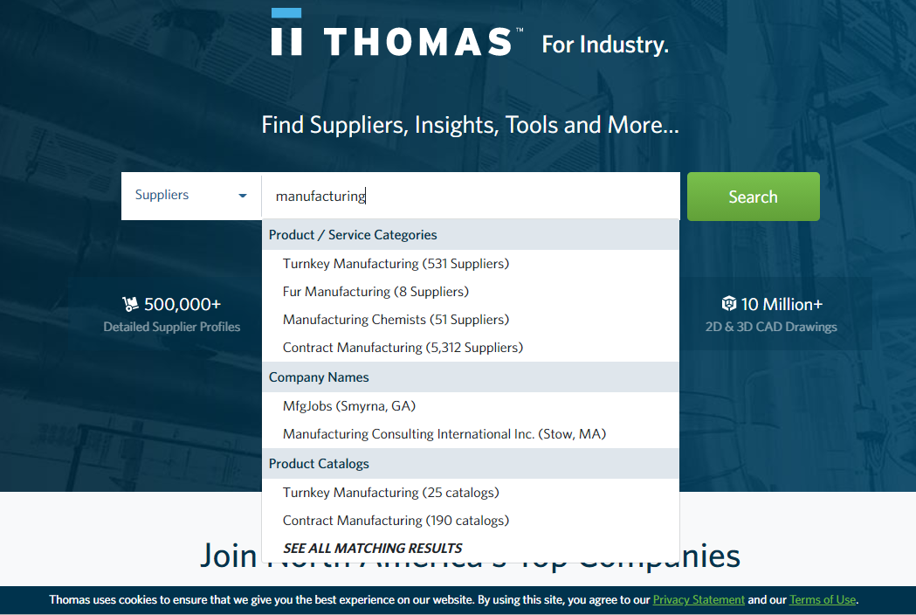
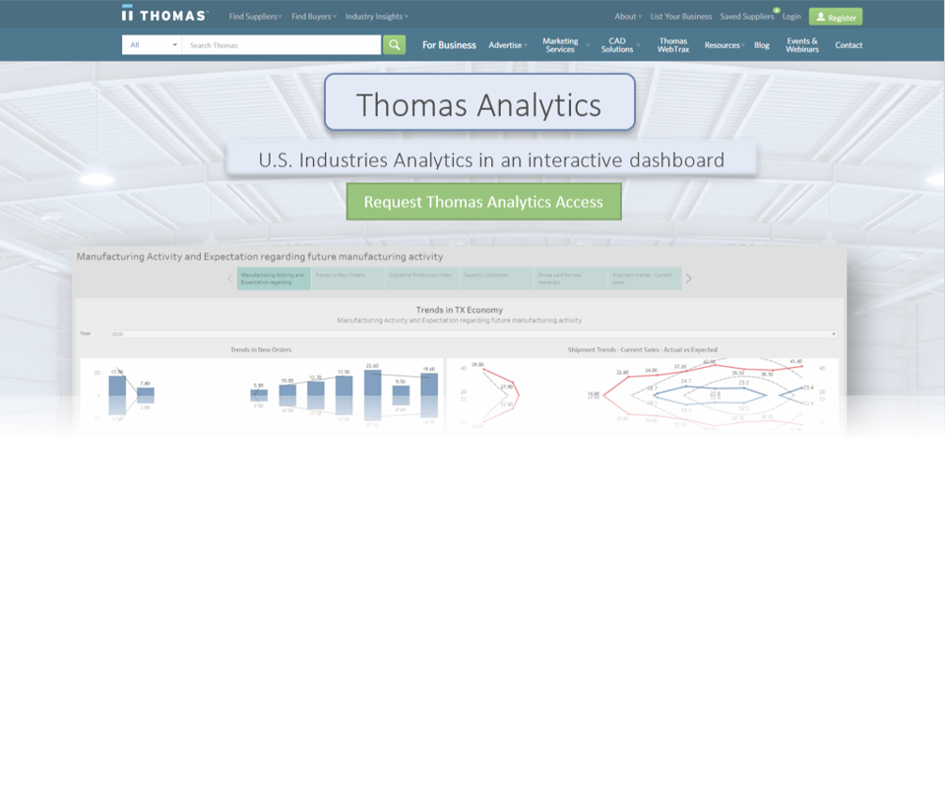
I want to set up a new business in Texas. Let’s see if it would be a good idea.
John Doe wants to take a step in the manufacturing sector and is thinking of opening a business in Texas.
He stumbles upon the Thomas Net website. He looks for manufacturing sector and finds all these other companies
listed with Thomas Net in this sector. He knows about the
ease of using Thomas Net and is wondering if his new firm
should get enlisted with the network as well.
He then finds the Thomas Analytics Dashboards and looks through the trends in daily, monthly, yearly demands, the most popular supplier industries which would help him think about what kind of business he should set up.

Slide 16

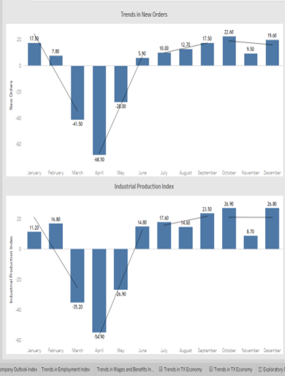
The conversion rate of these sectors which would provide foresight about the possibility of turning a profit, about getting prospective users directed to your website which would potentially generate more sales and turn a profit.
He finds another dashboard visualizing the
economic trends in the manufacturing sector
for a particular year.
He wants to know if getting into manufacturing in Texas would be a good idea, considering COVID massively affecting all the sectors. He looks at the trends for all these economic factors that drive the manufacturing sector.

Slide 17
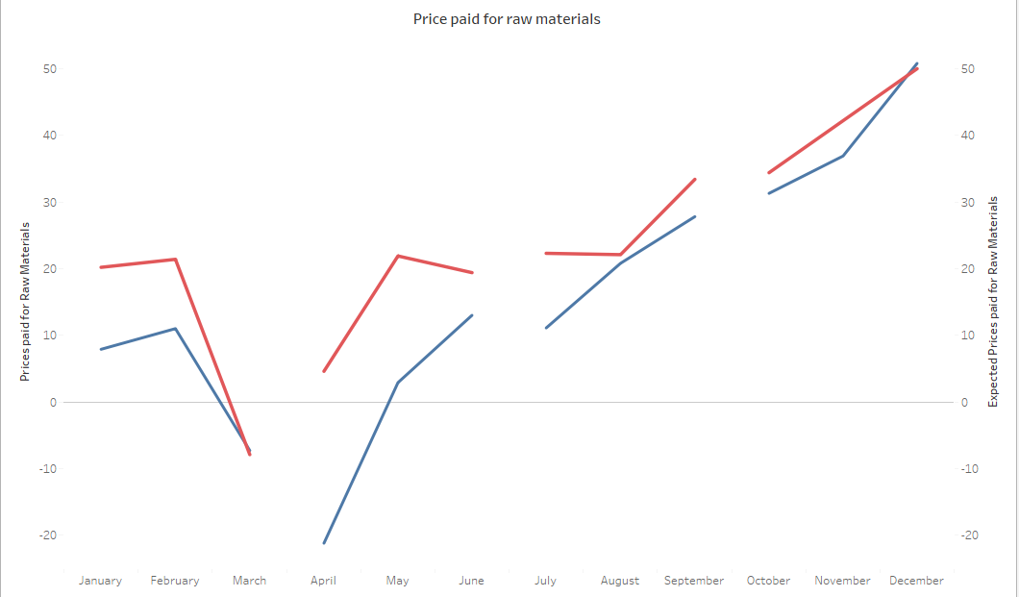

He looks at Price and Wage pressures like the prices paid for raw materials to see if Texas will be the best location to set up a business for manufacturing the products in demand.
For 2020, he sees a major difference between the expected prices and the actual prices and how the markets have stabilized after the major dip, for the experts to have realistic expectations and correctly forecast future
behavior in this sector.
He can now plan based on the economic trends and the visitor information, about the type of business he wants to set up, the location of his business and if enlisting with Thomas Net would help him increase his sales.

Slide 18
Cost structure Revenue streams
Yearly dashboard cost using tableau 3-user server $3000.
Labour Cost for 2 full-time employees at the rate of $150/hr will be $576,000.
Expert Advice Fee will be $50,000.
Marketing and overhead cost =$100,000
Total yearly cost = $726,000.
Thomasnet analytics aims at converting at least 5000 users into subscribers during the first year.
Thomas Analytics Dashboard yearly subscription cost $200 after 1 week free subscription
Total yearly revenue = $1,000,000
Thomas Analytics Dashboard Yearly profit approximately = $276,000
Notes:
Cost of creating and maintaining a professional website: $6000/year

Slide 19
Gross Profit- first 3 years
Year 1 - 5000 subscribers Profit - 274,000
Year 2 - 15000 subscribers Profit - 2,274,000
Year 3 - 50, 000 subscribers Profit - 9,274,000

Slide 20
